Slide 1

Major Project-I Presentation B.E. (Computer) Sem - VII
Lokmanya Tilak College of Engineering, Navi Mumbai
Computer Engineering
2020-21

Slide 2

Speech Emotion Recognition
Group members:
Ms. Divya Rawat 205
Ms. Shreya Parab 219
Ms. Vaishnavi Rai 223
Name of Project Guide:
Prof. Sonal Bankar

Slide 3
Presentation Outline
Abstract
Introduction
Literature Survey
Limitation of Existing system
Problem Statement and Objective
Scope
Proposed System
Analysis/Framework/ Algorithm
Details of Hardware & Software
Design details
Methodology
Implementation Plan for next semester
Conclusion
References

Slide 4
ABSTRACT
Speech emotion recognition is one of the latest challenges in speech processing.
Emotion recognition from the speaker’s speech is very difficult because of the following reasons:
In differentiating between various emotions which particular speech features are more useful is not clear.
Because of the existence of the different sentences, speakers, speaking styles, speaking rates accosting variability was introduced, because of which speech features get directly affected.
In this Python Project, we will use the libraries librosa, sound file, and sklearn (among others) to build a model using a MLP Classifier MLP Classifier stands for Multi-layer Perceptron classifier which in the name itself connects to a Neural Network.

Slide 5
INTRODUCTION
In today’s digital era, speech signals become a mode of communication between humans and machines which is possible by various technological advancements.
Speech emotion recognition is one of the latest challenges in speech processing.
Besides human facial expressions speech has proven as one of the most promising modalities for the automatic recognition of human emotions.
This leads to Speech Emotion Recognition(SER) growing research topic in which lots of advancements can lead to advancements in various field like automatic translation systems, machine to human interaction, used in synthesizing speech from text so on.
Emotion can be recognized from facial expressions , speech signals.
Each emotion may correspond to the different portions of the spoken utterance. Therefore it is very difficult to differentiate these portions of utterance

Slide 6
LITERATURE SURVEY
Sr. No | Authors | Title of the paper & year of publ.(Old to recent ) | Major contributions
1 | SG Koolagudi and SR Krothapalli | Emotion Recognition | Emotion Recognition from pitch using sub syllabic and pitch synchoronous spectral features
2 | J.Rong, G Li and Y.P.P Chen | Emotion Recognition from speech | Acoustic Feature selection for automatic emotion recognition from speech.

Slide 7
LIMITATION OF EXISTING SYSTEM
Coping With Additive Noise
Labelling Of Emotion
Selection Of Classifier

Slide 8
PROBLEM STATEMENT
Speech is one of the ancient ways to express ourselves.
Speech Emotion Recognition is the act of attempting to recognize human emotion and affective states from speech.
The evaluation of the speech emotion recognition system is based on the level of naturalness of the sound/speech.
Hence, It is more practical to use database that is collected from the real life situations.
OBJECTIVE
The Objective of this project is to build a model to recognize emotion from speech using librosa and sklearn libraries and RAVDESS dataset.
The main goal of this project is to build a simple yet complete representative emotion recognition system.

Slide 9
SCOPE
Scope
In Medical Field
In Customer Service
In Recommendation Systems

Slide 10
PROPOSED SYSTEM
The MLP-Classifier is used to classify the emotions from the given wave signal.
The MLP is made to train on the given dataset.
The training phase enables the MLP to learn the correlation between the set of inputs and outputs.
Speech Input
Preprocessing
Analysis
MLP Classifier
Result
Feature Extraction

Slide 11
ANALYSIS
In the Speech Emotion Recognition System (SER), the audio files are given as the input.
The data sets travels through a number of blocks of processes which makes it executable to help for the analysis of the speech parameters.
The data is preprocessed to change it to the suitable format and the respective features from the audio files are extracted using various steps
After the extraction of the required features from the audio files, the model is trained.
For the training, we store the numerical values of emotions and their respective features correspondingly in different arrays. These arrays are given as an input to the MLP Classifier
The Classifier identifies different categories in the datasets and classifies them into different emotions.

Slide 12
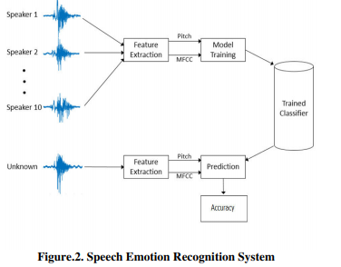
ANALYSIS
For testing the performance of the model, if we enter the unknown test dataset as an input, it will retrieve the parameters and predict the emotion as per training dataset values.
The accuracy of the system is displayed in the form of percentage which is the final result of our project.

Slide 13
DETAILS OF HARDWARE AND SOFTWARE
Hardware Requirements:
4 GB RAM or above
Intel core i3 or above
Minimum Disk Space -500MB
Software Requirements:
Anaconda
Jupyter notebook
Data set

Slide 14
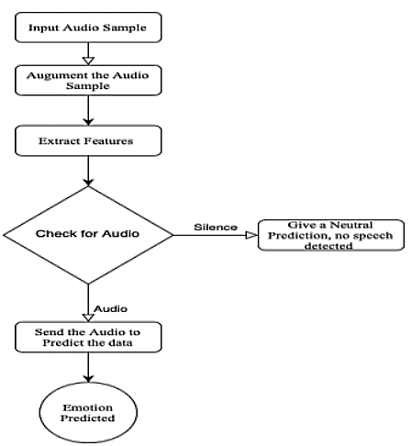
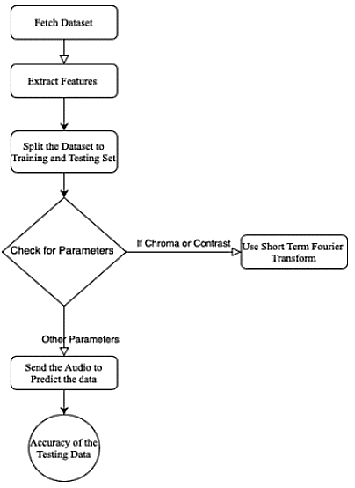
DESIGN DETAILS

Slide 15
METHODOLOGY
Make the necessary imports
Define a function extract_feature to extract the mfcc, chroma, and mel features from a sound file. This function takes 4 parameters- the file name and three Boolean parameters for the three features:
mfcc: Mel Frequency Cepstral Coefficient, represents the short-term power spectrum of a sound
chroma: Pertains to the 12 different pitch classes
mel: Mel Spectrogram Frequency
Define a dictionary to hold numbers and the emotions available in the RAVDESS dataset, and a list to hold those we want- calm, happy, fearful, disgust.
Now, load the data with a function load_ data()
split the dataset into training and testing sets
Observe the shape of the training and testing data. And get the number of features extracted.
Now, initialize an MLPClassifier. This is a Multi-layer Perceptron Classifier; it optimizes the log-loss function using LBFGS or stochastic gradient descent.
Fit/train the model.
To calculate the accuracy of our model, call up the accuracy_score() function imported from sklearn

Slide 16
IMPLEMENTATION PLAN FOR NEXT SEMESTER
Feature Extraction
Splitting the data for training (75%) and testing (25%)
Initializing the MLP classifier
Training and testing data
Calculate the accuracy of the model

Slide 17
CONCLUSION
In this project , we will learn to recognize emotions from speech.
We will use MLP classifier for this and will also be using the soundfile library to read the sound file, and the librosa library to extract features from it.

Slide 18
REFERENCES
S. G. Koolagudi and S. R. Krothapalli, “Emotion recognition from speech using sub-syllabic and pitch synchronous spectral features”
J. Rong, G. Li, and Y. P. P. Chen, “Acoustic feature selection for automatic emotion recognition from speech”

Slide 19
Thank You!

